Slide 1
Jumping for JavaScript
Lesson 3.2

Slide 2
Today’s Class
Jumping for JavaScript

Slide 3
Objectives
In today’s class, we’ll cover:
Array Assignments
The Concept of for Loops
The Art of Pseudocoding
Building Rock-Paper-Scissors
Jumping for JavaScript

Slide 4
Basics Recap
Jumping for JavaScript

Slide 5

What is JavaScript?
(And what is it used for?)
Jumping for JavaScript

Slide 6


JavaScript Definitions
JavaScript is the third of the three fundamental programming languages of the modern web (along with HTML and CSS).
JavaScript allows developers to create dynamic web applications capable of taking in user inputs, changing what’s displayed to users, animating elements, and much more.
Jumping for JavaScript

Slide 7
What is a Variable?
(And how do we declare one?)
Jumping for JavaScript

Slide 8
Variable Basics
Variables are the nouns of programming.
They are “things” (numbers, strings, Booleans, etc.).
A variable is composed of a variable name and a value.
var name = "Snow White"; var dwarfCount = 7; var isSleeping = true;
Jumping for JavaScript

Slide 9
What is meant by console.log?
(And how does it differ from an alert, prompt, or confirm?)
Jumping for JavaScript

Slide 10
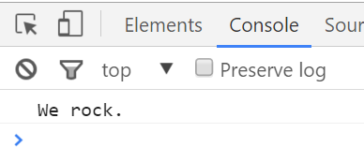
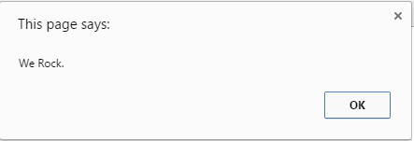
Console.log vs. JavaScript popup boxes
console.log displays discreetly to the debugger.
alert displays a pop-up message to the user.
console.log("We rock.");
alert("We Rock.");
Jumping for JavaScript

Slide 11
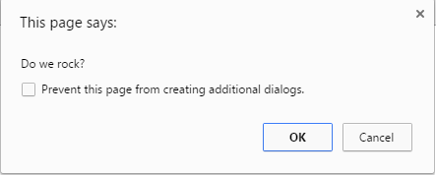
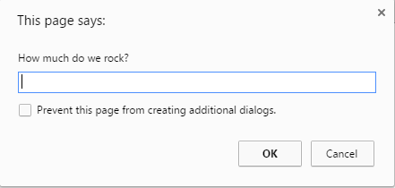
Console.log vs. JavaScript popup boxes
confirm displays a true/false popup.
prompt displays a popup with a text-box input.
confirm("Do we rock?");
prompt("How much do we rock?");
Jumping for JavaScript

Slide 12
How do we check conditions?
Jumping for JavaScript

Slide 13
If/Else statements are critical
Each statement is composed of an if, else-if, or else (keyword), a condition, and the resulting code in { } curly brackets.
// If the user likes sushi (confirmSushi === true), we run the following block of code. if (confirmSushi) { alert("You like " + sushiType + "!"); } // If the user likes ginger tea (confirmGingerTea === true), we run the following block of code. else if (confirmGingerTea) { alert("You like ginger tea!!"); } // If neither of the previous condition were true, we run the following block of code. else { alert("You don’t like sushi or ginger tea.");

Slide 14
What is an array?
Jumping for JavaScript

Slide 15
Basic Arrays
Arrays a type of variable that are collections.
These collections can be made up of strings, numbers, Booleans, other arrays, objects, anything.
Each element of the array is marked by an index. Indexes always start with 0.
var nickCharacters = ["Tommy", "Doug", "Oblina"]; var diceNumbers = [1, 2, 3, 4, 5, 6,]; var mixedArray = ["Zoo", 12, "Carrot", 3];

Slide 16
Activity: Basic JavaScript Dissection
3 minutes

Slide 17
Activity: Basic JavaScript Dissection
Suggested Time: 3 minutes
Re-examine the file sent to you during yesterday’s class.
See if you can better understand how it works—at this point in today’s class.
Prepare to share once the time is up.
Jumping for JavaScript

Slide 18
Activity: Array Logging
5 minutes

Slide 19


Activity: Array Logging
Suggested Time: 5 minutes
Follow the instructions provided in the file to console.log each of the names in the coolPeople variable.
Hint: You should be repeating the same line 6 times.
Be prepared to share once time is up.
Jumping for JavaScript

Slide 20
Activity: Array Setting
5 minutes

Slide 21
Activity: Array Setting
Suggested Time: 5 minutes
Follow the instructions in the file provided to convert each item in the array to lowercase.
Make sure to only add in lines of code where instructed.
Hint: You will need to use the method .toLowerCase(). Research if you don’t remember how to use it.
Be prepared to share when time is up.
Jumping for JavaScript

Slide 22
Back to The Zoo Pen
Array Name: zooAnimals
Coded in JavaScript using an Array
Coded in JavaScript using an Array
Zebra | Rhino | Giraffe | Owl
Index 0 | Index 1 | Index 2 | Index 3
// Our array of zoo animals. var zooAnimals = ["Zebra", "Rhino", "Giraffe", "Owl"];

Slide 23
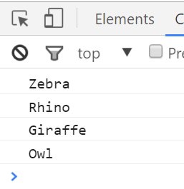
Back to The Zoo Pen
Array Name: zooAnimals
Coded in JavaScript using an Array
Zebra | Rhino | Giraffe | Owl
Index 0 | Index 1 | Index 2 | Index 3
// Array of zoo animals. var zooAnimals = ["Zebra", "Rhino", "Giraffe", "Owl"]; console.log(zooAnimals[0]); console.log(zooAnimals[1]); console.log(zooAnimals[2]); console.log(zooAnimals[3]);

Slide 24
What’s wrong here?
// Array of zoo animals. var zooAnimals = ["Zebra", "Rhino", "Giraffe", "Owl"]; console.log(zooAnimals[0]; console.log(zooAnimals[1]; console.log(zooAnimals[2]; console.log(zooAnimals[3];
Jumping for JavaScript

Slide 25
Don’t Repeat Yourself (DRY)
Repeated Code! Let’s be more efficient.
// Array of zoo animals. var zooAnimals = ["Zebra", "Rhino", "Giraffe", "Owl"]; console.log(zooAnimals[0]; console.log(zooAnimals[1]; console.log(zooAnimals[2]; console.log(zooAnimals[3];
Jumping for JavaScript

Slide 26
Activity: For Loop Dissection
5 minutes

Slide 27
Activity: For Loop Dissection
Suggested Time: 5 minutes
With a partner, spend a few moments trying to dissect the code sent to you.
Try to explain to one another what is happening in each line of code.
Feel free to do research if you are stumped. As a hint, look into the phrase “for loop”.
Be prepared to share when time is up.
Jumping for JavaScript

Slide 28
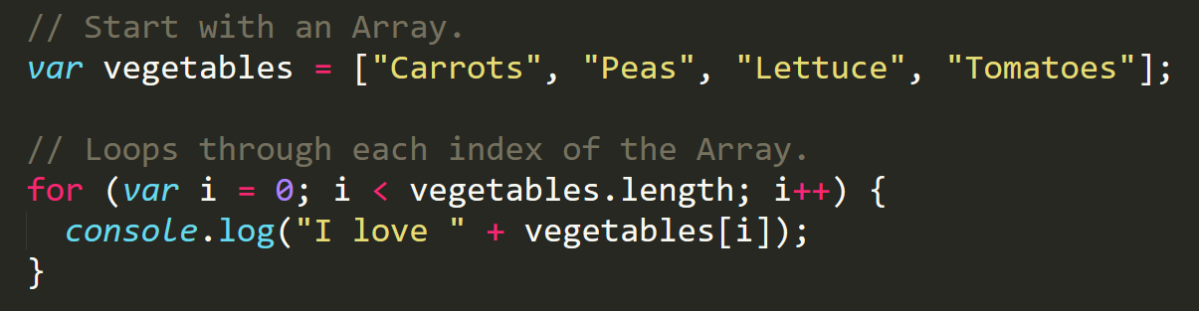
Enter the For Loop
For loops are critical in programming. We use for loops to run repeated blocks of code over a set period.
Each for loop is composed of a:
Variable declaration or counter (iterator)
Loop condition
Iteration (addition)
Jumping for JavaScript

Slide 29
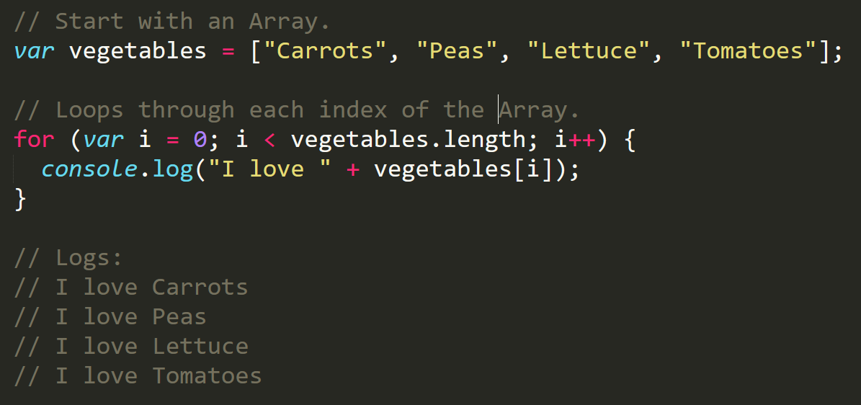
Enter the For Loop
Iterator
Condition
Increment
Jumping for JavaScript

Slide 30
Enter the For Loop
Code between the { } gets repeated each time the iterator is smaller than the condition (in this case, as long as i < 4).
Jumping for JavaScript

Slide 31
Enter the For-Loop
Running the code “loops” through and prints each element in the array.
Jumping for JavaScript

Slide 32
Run That Loop
When i = 0 … console.log(“I love Carrots”)
Carrots | Peas | Lettuce | Tomatoes
Index 0 | Index 1 | Index 2 | Index 3
Jumping for JavaScript

Slide 33
Run That Loop
When i = 1 … console.log(“I love Peas”)
Carrots | Peas | Lettuce | Tomatoes
Index 0 | Index 1 | Index 2 | Index 3
Jumping for JavaScript

Slide 34
Run That Loop
When i = 2 … console.log(“I love Lettuce”)
Carrots | Peas | Lettuce | Tomatoes
Index 0 | Index 1 | Index 2 | Index 3
Jumping for JavaScript

Slide 35
Run That Loop
When i = 3 … console.log(“I love Tomatoes”)
Carrots | Peas | Lettuce | Tomatoes
Index 0 | Index 1 | Index 2 | Index 3
Jumping for JavaScript

Slide 36
Activity: For Loop Zoo
15 minutes

Slide 37
Activity: For Loop Zoo
Suggested Time: 15 minutes
01
Spend a few moments rewriting the code below using a for loop.
02
If you need help, use the code from the previous example as a guide.
03
Then try to explain to the person next to you how your code works.
// Array of zoo animals. var zooAnimals = ["Zebra", "Rhino", "Giraffe", "Owl"]; console.log(zooAnimals[0]; console.log(zooAnimals[1]; console.log(zooAnimals[2]; console.log(zooAnimals[3];
Jumping for JavaScript

Slide 39
Activity: Another Loop
15 minutes

Slide 40

Activity: Another Loop
Suggested Time: 15 minutes
Starting from scratch, create a for loop that prints the following lines:
I am 0
I am 1
I am 2
I am 3
I am 4
This time, don’t use an array!
Jumping for JavaScript

Slide 41
Group Activity (2 people): Loop with Conditions
10 minutes

Slide 42
Group Activity: Loop with Conditions
Suggested Time: 10 minutes
Starting from scratch, write code that loops through the following array:
Use console.log to display the name of each animal on the farm.
Using the .charAt() method (research it), check if the first letter in the animal’s name begins with a “c” or “o”. If it does, create an alert saying: “Starts with c or an o!”
Jumping for JavaScript

Slide 43
Activity: Random Numbers
7 minutes

Slide 44
Activity: Random Numbers
Suggested Time: 7 minutes
Research how to use Math.random() to generate a whole number between 1 and 10.
Open 21-RandomNumbers/Unsolved and modify the code so that is logs random whole numbers from 1 to 10 inclusive.
Jumping for JavaScript

Slide 45

Rock-Paper-Scissors with the Person Next to You!
Play five rounds.
Jumping for JavaScript

Slide 46
Group Activity (2 people): Pseudocode Rock-Paper-Scissors (RPS)
3 minutes

Slide 47
Group Activity: Pseudocode RPS
Suggested Time: 8 minutes
With a partner, spend a few moments outlining all the steps and conditions that go into a single game of rock paper scissors.
Try to break it down into steps that you could “code out.”
Think of basic elements like loops, if-then statements, arrays, alerts, etc.
Be prepared to share your outlined approach.
Jumping for JavaScript

Slide 48

You just pseudocoded!
Jumping for JavaScript
Notes:
shutterstock_288649979

Slide 49
And now, for the rest of the class … YOU will be coding it out!
Jumping for JavaScript

Slide 50
Don’t worry. We’ll be here to help you along the way.
Jumping for JavaScript

Slide 51
Group Challenge (4 people): Coding Out RPS
60 minutes
Jumping for JavaScript

Slide 52
Group Challenge: Coding out RPS
Suggested Time: 60 minutes
In groups of four, begin the process of coding out the rock-paper-scissors game.
Do as much as you can on your own, but don't be afraid to ask for help if you feel your team is struggling.

Slide 53
Let’s Fill in the Missing Code (Together)
Jumping for JavaScript

Slide 54
Questions?
Jumping for JavaScript

